Slide 1
BARKAT PROJECT
ZAFAR IQBAL

Slide 2
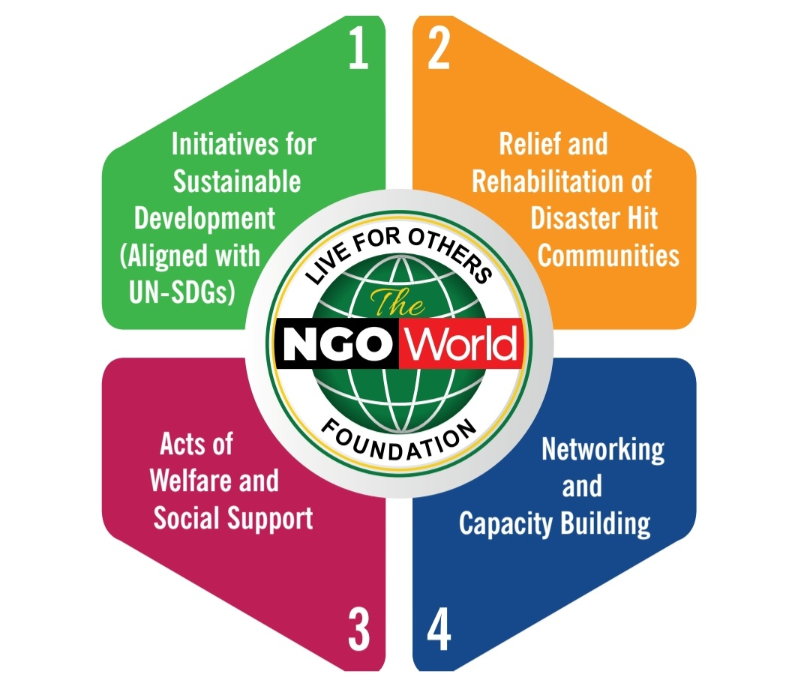
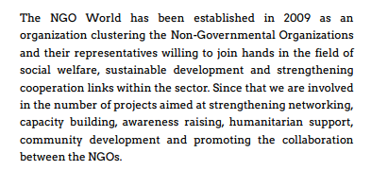
INTRODUCTION

Slide 3
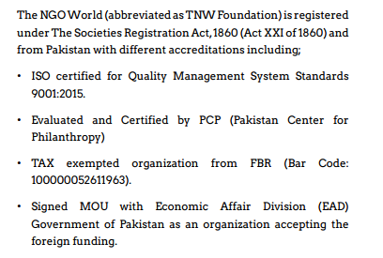
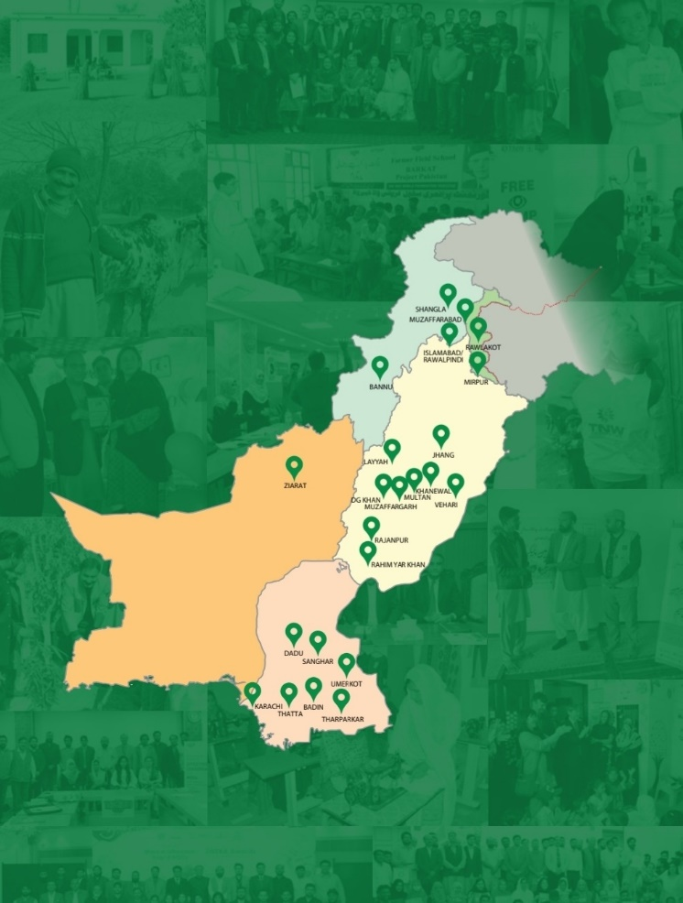
INTRODUCTION

Slide 5
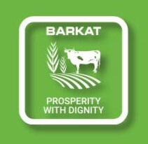
2012
keeping in view the situation of poverty in rural areas and importance of livestock, TNW Foundation launched a livestock-based poverty alleviation program titled “BARKAT” by initially distributing 100 cows (heifer) and 200 goats to small home based livestock farmers on partnership.

Slide 6
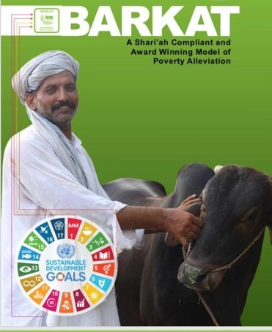
A special kind of partnership,
Barkat Project provides
the Cattle (rabb-ul-maal)
to the
FARMER (mudarib)
as investment.
Both parties share profit and loss

Slide 7
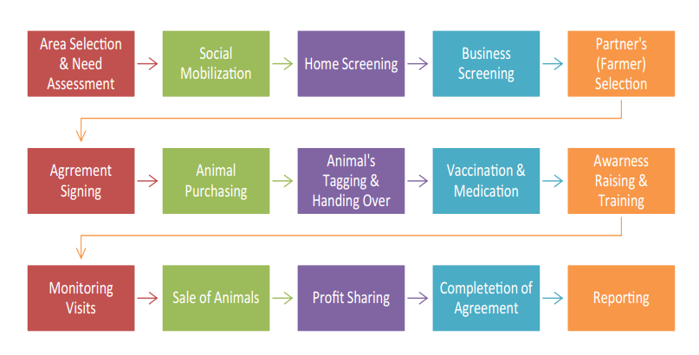
BARKAT PROJECT CYCLE - QURBANI

Slide 8
VIDEO DOCUMENTARY

Slide 9
STRENGTHS & POTENTIAL
Once started; It is self SUSTAINABLE
Develops a CHAIN of beneficiaries
CONVENTIONAL and well documented
COMPATIBLE with nature and values of rural communities
Farmers ADOPT it as a noble profession
Easy to MARKET (Qurbani)

Slide 10
STRENGTHS & POTENTIAL
PROFITABLE (business and hobby)
RECOVERY is 100%
CLIMATE FRIENDLY (Natural resources, soil improvement)
Shari’ah COMPLIANT
It can be started as SOCIAL ENTERPRISE
There is potential for EXPANSION & REPLICATION

Slide 11
BARKAT PROFIT
Barkat Mudarabah
Year | Bugdet (PKR) | Benefit to Partners | Benefit to TNW | Total Benefit(PKR) | Benefit Partners %
2020 | 12,794,000 | 6,031,115 | 2,985,308 | 9,016,423 | 70
2021 | 14,985,180 | 6,063,880 | 3,031,940 | 9,095,820 | 61
2022 | 17,135,470 | 6,276,953 | 3,138,477 | 9,415,430 | 55

Slide 12
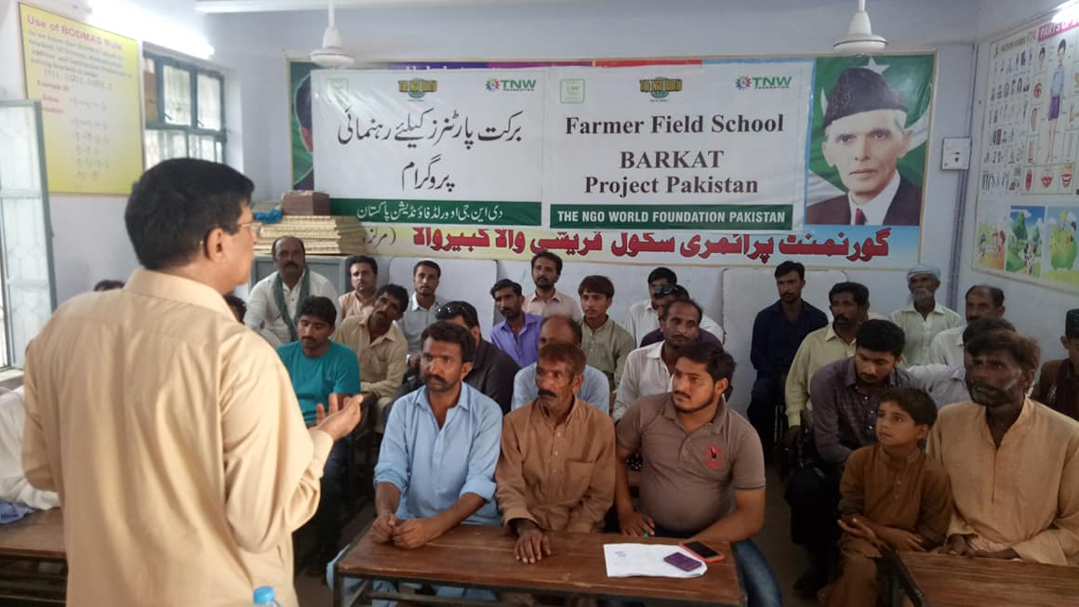
BARKAT PROFIT
BETTER
USE OF
PROFIT

Slide 13
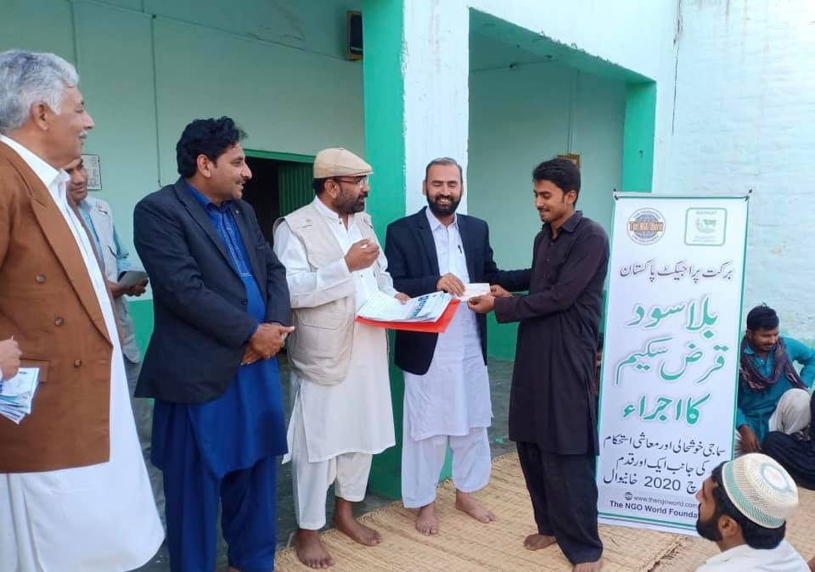
BARKAT LOANS
2020
BARKAT(Mudarabah)
have been coupled with
LOANS
to promote small BUSINESSES

Slide 14
COME with BARKAT to bring prosperity
NGOs/Donors
Business Company
CSR & Philanthropists
Social Entrepreneurs
Individuals

